Slide 1
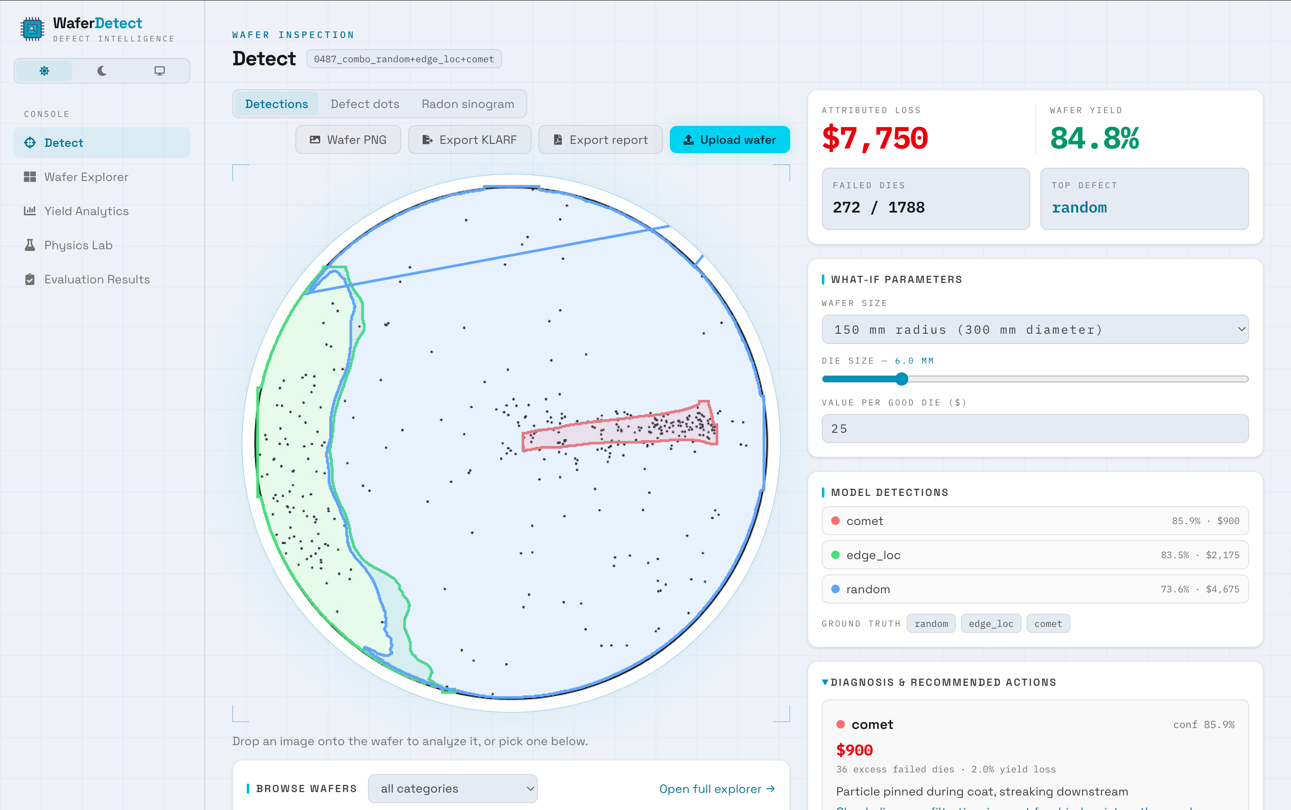
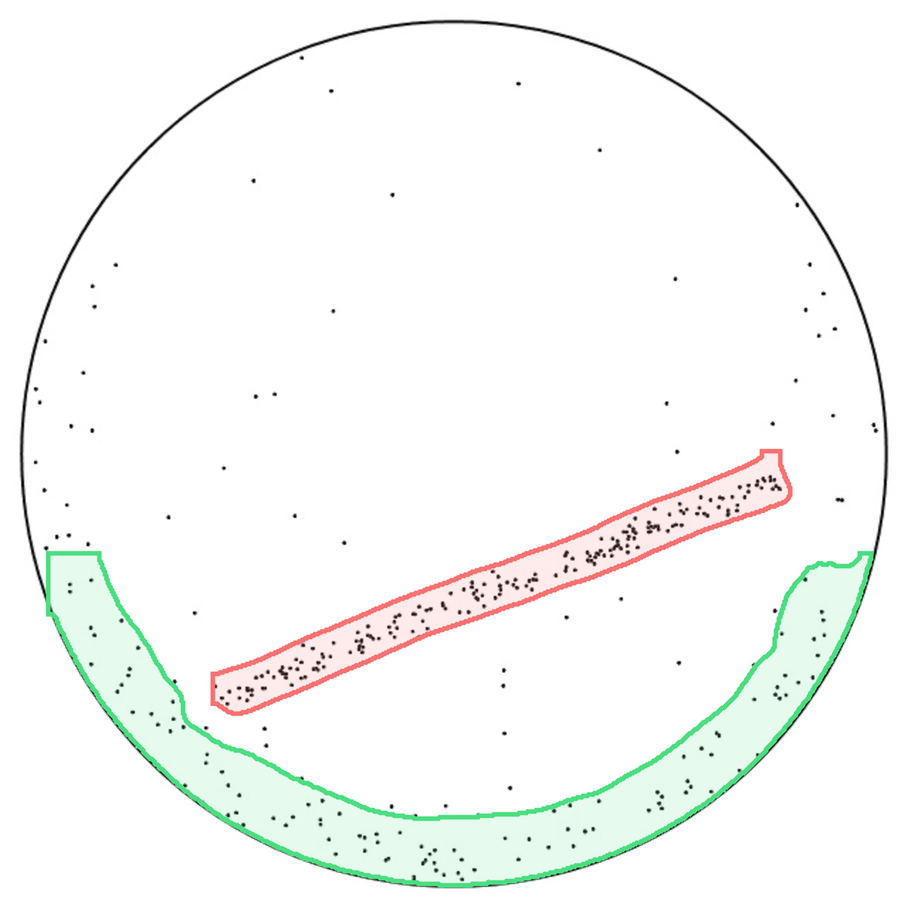
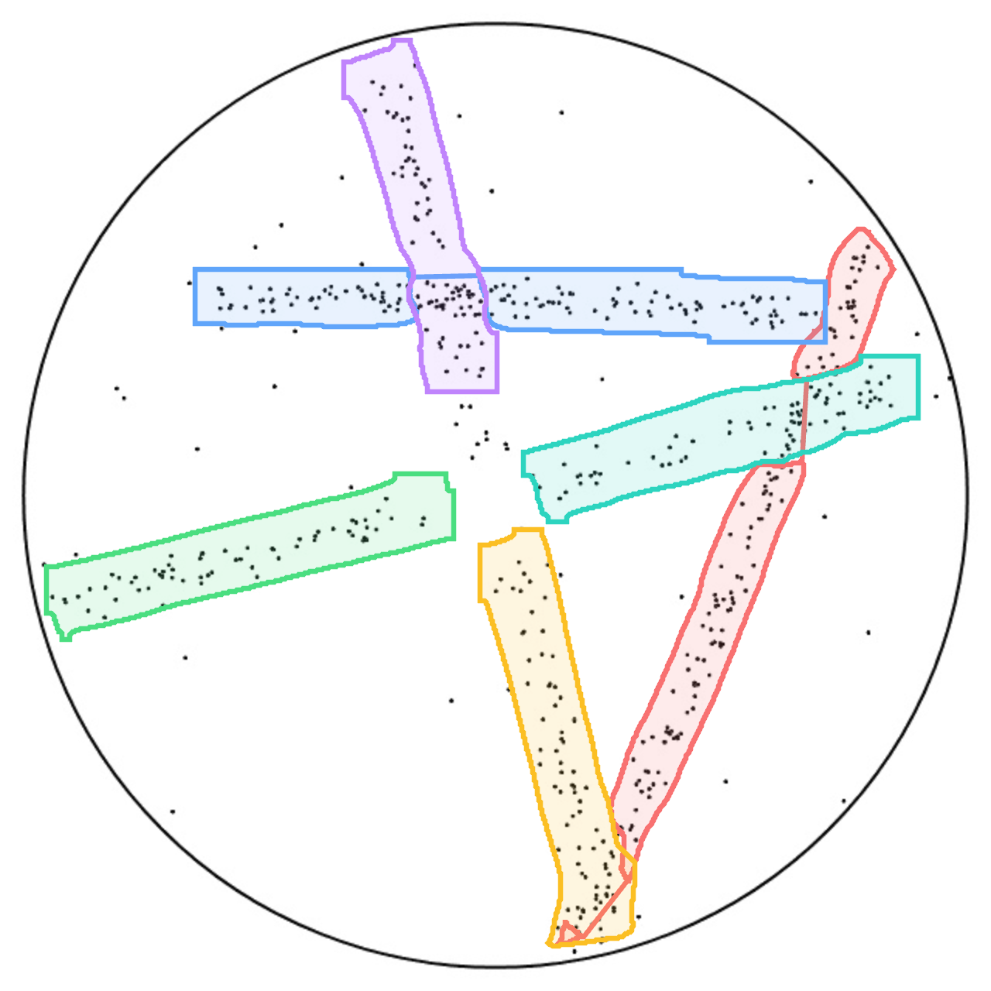
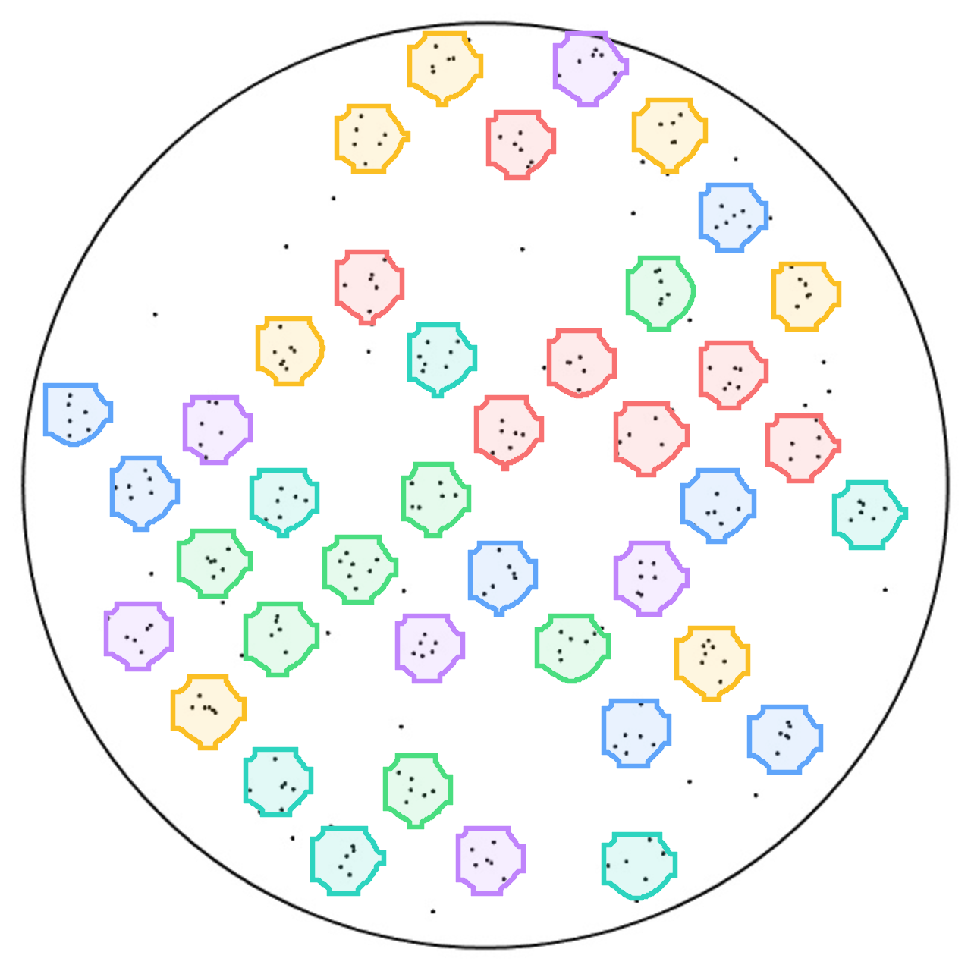
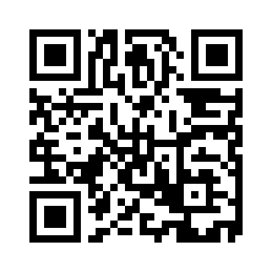


WaferDetect: Segmenting Complex Defect Patterns in Silicon Wafers with YOLO for Root-Cause Diagnosis
Non-Cognitive Predictors of Student Success: A Predictive Validity Comparison Between Domestic and International Students
Non-Cognitive Predictors of Student Success: A Predictive Validity Comparison Between Domestic and International Students
INTRODUCTION
Chips power everyday tech from phones and cars to AI tools, making semiconductor supply a major news issue. Semiconductor fabrication labs (fabs) build chips on silicon wafers through hundreds of steps. Every die (chip) on a wafer is electrically tested, and defective dies form a pattern linked to a root cause: scratches indicate handling damage, rings indicate polishing drift, slip lines indicate thermal stress, etc. With single wafers worth up to $25k, misreading errors or failing to correct them is expensive. Yet prior works assign each wafer a single label with no location, no overlapping defects, and no way to measure cost.
METHODOLOGY
Dataset: 580 annotated silicon wafer maps, spanning 21 defect pattern classes.
Model Architecture: YOLO26x segmentation model, a single-pass detector with a convolutional backbone that extracts features at multiple scales as input to parallel heads that predict each defect's class, box, and pixel mask together, outlining every defect.
Analysis: Each detection queries a root-cause knowledge base for the manufacturing error, recommended action, and the yield model used to quantify failed dies and dollars lost.
RESULTS
For each silicon wafer map image, run the YOLO model and compute the Box and Mask Mean Average Precision (mAP).
The test set consists of 87 wafers, containing all 21 classes.
DISCUSSION & FUTURE WORKS
In a real fab line, automating the detection and cost analysis process can save fabs millions of dollars. Because the model is single-pass and runs in milliseconds, it can sit directly on a live, real-time wafer-test data stream, segmenting each wafer map as it comes off the prober, flagging errors across lots and alerting engineers to defects before they damage more wafers.
REFERENCES
Bao, Y.-Y., Li, E.-C., Yang, H.-Q., & Jia, B.-B. (2024). Wafer map defect classification using autoencoder-based data augmentation and convolutional neural network. arXiv. https://doi.org/10.48550/arXiv.2411.11029
Jocher, G., Qiu, J., Liu, M., Lyu, S., Akyon, F. C., & Kalfaoglu, M. E. (2026). Ultralytics YOLO26: Unified real-time end-to-end vision models. arXiv. https://doi.org/10.48550/arXiv.2606.03748
Wu, M.-J., Jang, J.-S. R., & Chen, J.-L. (2015). Wafer map failure pattern recognition and similarity ranking for large-scale data sets. IEEE Transactions on Semiconductor Manufacturing, 28(1), 1–12. https://doi.org/10.1109/TSM.2014.2364237
 | Box mAP | Mask mAP
Full Test | 0.909 | 0.852
Combo | 0.782 | 0.686
Edge Scratch Tiny | 0.995 | 0.995
Rishab Alagharu
Scan to View Source Code

